Slide 1
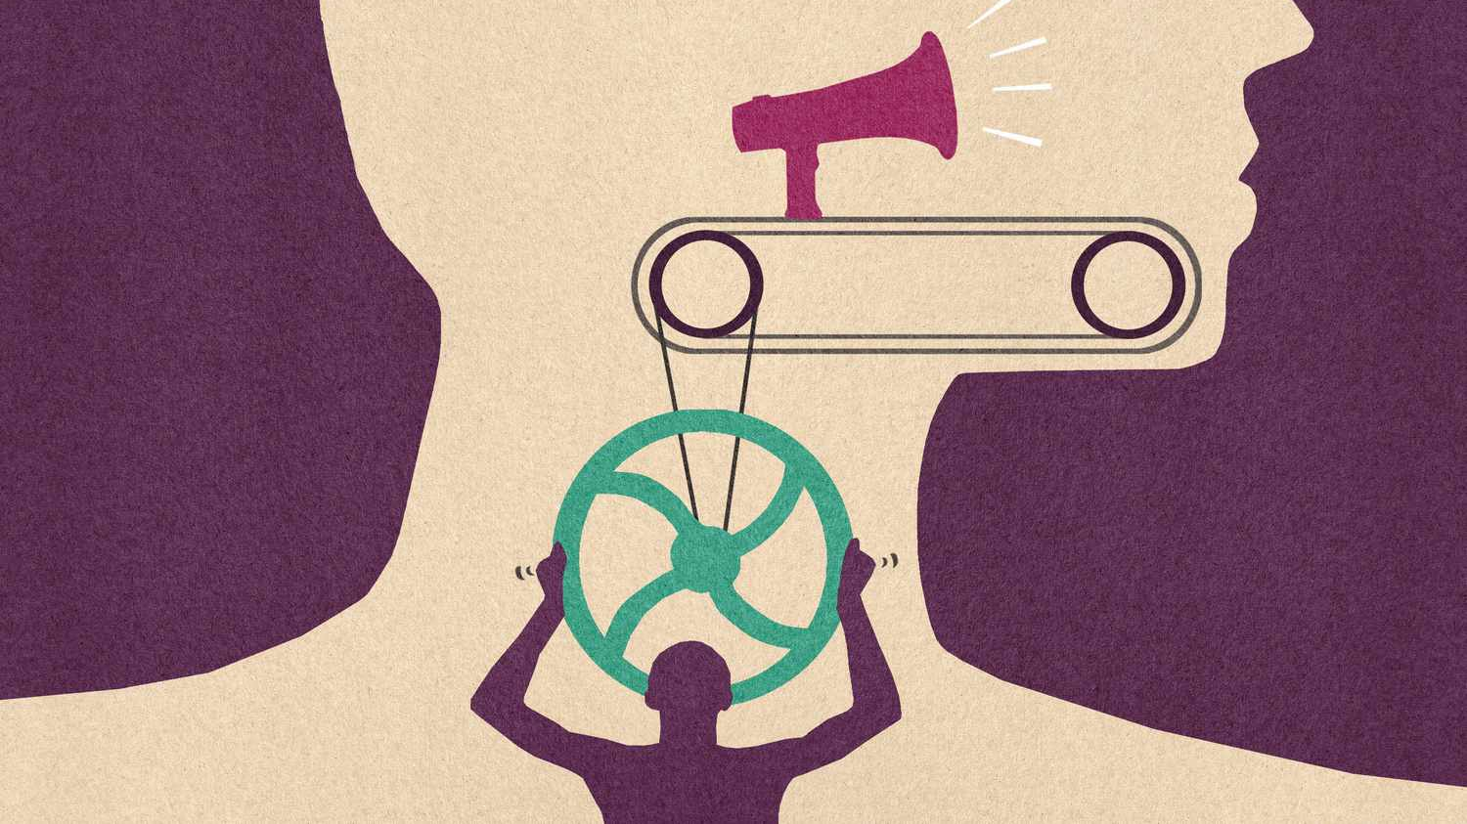
Phonetic Transcription
106121107
Rohith Kumar V

Slide 2
Phonetics
Phonetics is a branch of linguistics that studies how humans produce and perceive sounds or, in the case of sign languages, the equivalent aspects of sign.

Slide 3
Importance of phonetics in linguistics
Easily recognize the sound each letter makes and how they must be pronounced when they are in combination.
Though → /ðoʊ/ → The "gh" is silent,
Tough → /tʌf/ → The "gh" makes an /f/ sound,
Ghost → /ɡoʊst/ → The "gh" makes a /g/ sound.

Slide 4
Importance of phonetics in linguistics
Guides the learner in decoding the sound.
Example: The word "knife" → /naɪf/
Although the letter "k" is silent, phonetic transcription helps learners recognize that only the /n/ sound is pronounced at the beginning.

Slide 5
Importance of phonetics in linguistics
Helps them to know how a word must be spelt out while writing.
Example: The word "receive" → /rɪˈsiːv/
The /rɪ/ sound indicates the spelling with "re" at the beginning, while the /iːv/ sound guides the learner to use "ie" instead of "ei" in the middle, reinforcing correct spelling patterns.

Slide 6
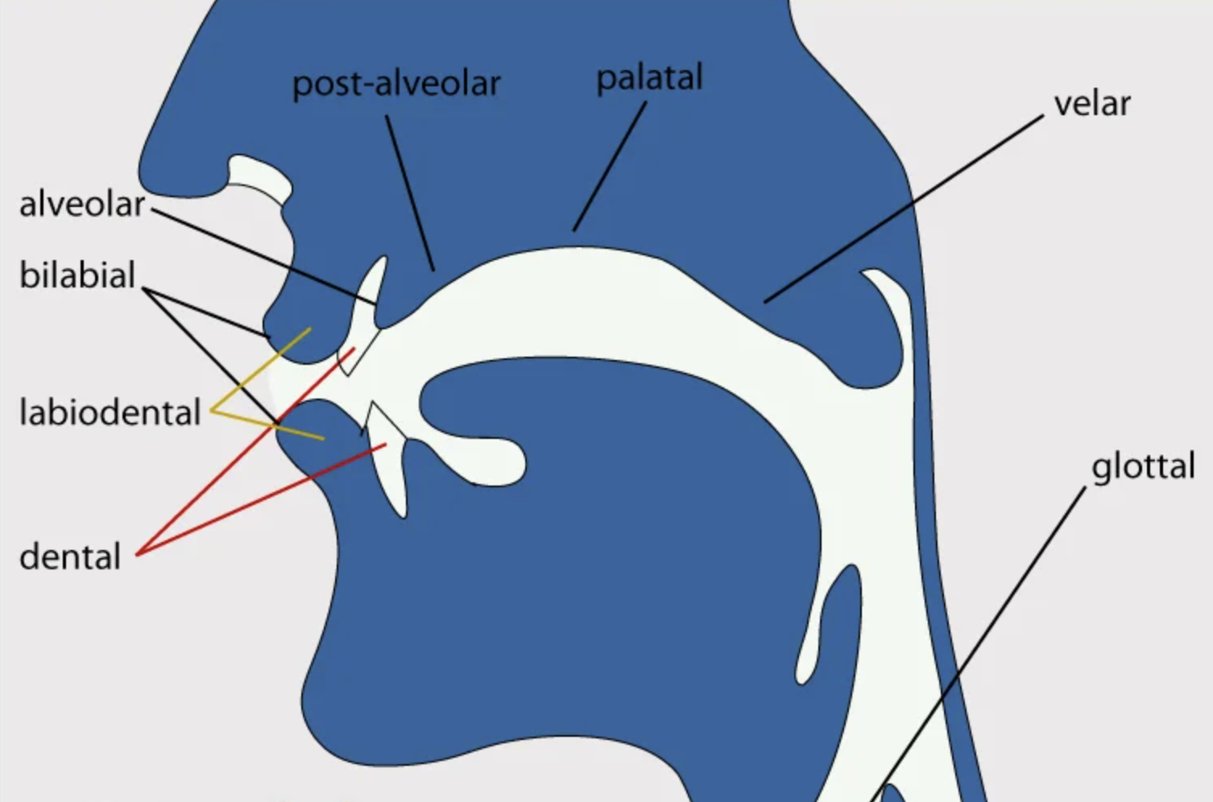
Basics of speech sounds
Articulatory Phonetics: How Speech Sounds are Produced
How speech organs (lips, tongue, vocal cords, etc.) produce sounds.
Key Articulators Involved:
Lips: Used for bilabial sounds (e.g., /p/, /b/)
Tongue: Shapes the airflow to produce different sounds
Vocal cords: Vibrate to produce voiced sounds (e.g., /z/) or remain open for voiceless sounds (e.g., /s/)
Glottis: Space between the vocal cords, involved in glottal sounds (e.g., /h/)
Examples:
/t/ → produced by the tongue touching the alveolar ridge
/m/ → produced by closing both lips (bilabial)

Slide 7
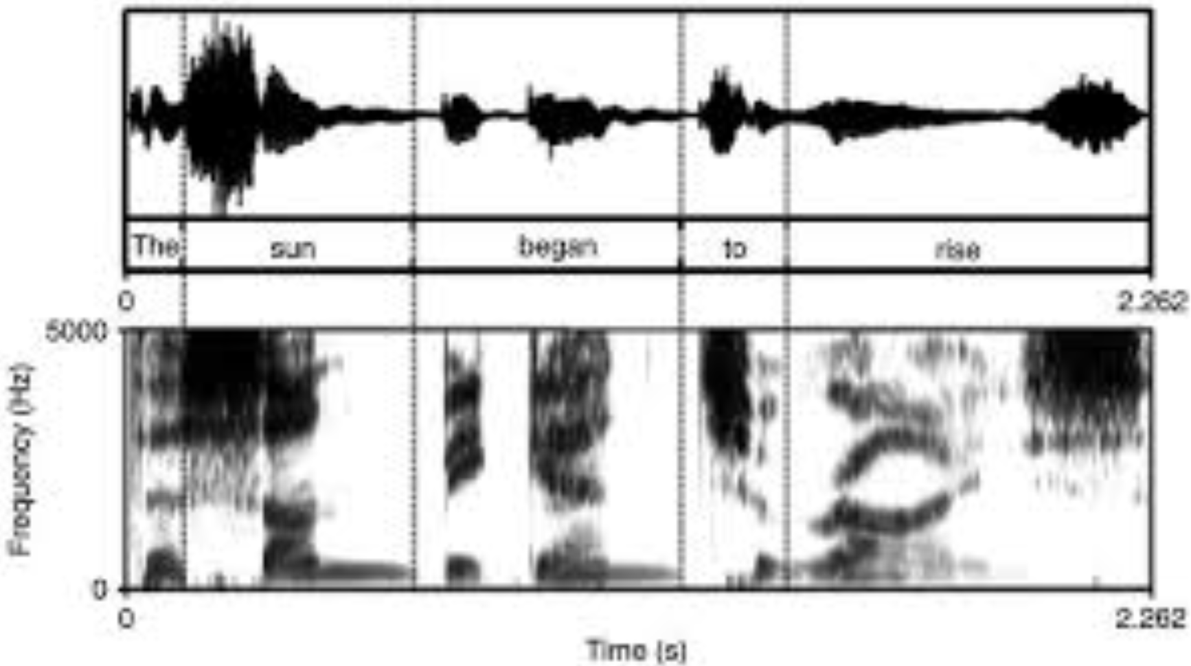
Basics of speech sounds
Acoustic Phonetics: How Sounds Travel Through Air
Studies the physical properties of speech sounds as they travel through air.
Key Properties:
Frequency: The pitch of the sound (measured in Hz)
Amplitude: The loudness of the sound
Duration: The length of time a sound is produced
Waveforms and Spectrograms:
Waveform: Shows variations in amplitude over time
Spectrogram: Displays frequency, intensity, and time
Examples:
Vowels → have clear formant patterns on spectrograms
Consonants → display abrupt changes in waveform

Slide 8
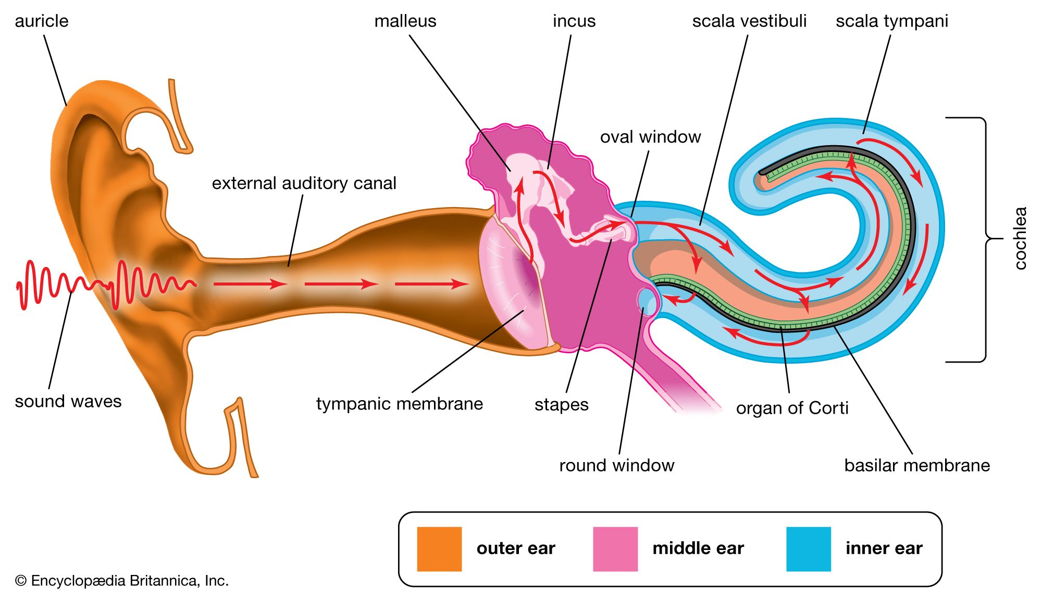
Basics of speech sounds
Auditory Phonetics: How Sounds are Perceived
Definition: It focuses on how the human ear and brain perceive and interpret speech sounds.
Hearing Process:
Sound waves enter the ear canal → vibrate the eardrum → transmitted through the ossicles → converted into electrical signals in the cochlea → processed by the auditory cortex
Phoneme Perception:
Our brain categorizes subtle sound variations as distinct phonemes.
Example: The difference between /l/ and /r/ is perceived clearly by native English speakers but may be difficult for non-native learners.
Examples:
Minimal pairs: Words that differ by only one phoneme, testing sound perception.
Example:
bit → /bɪt/
beat → /biːt/

Slide 9
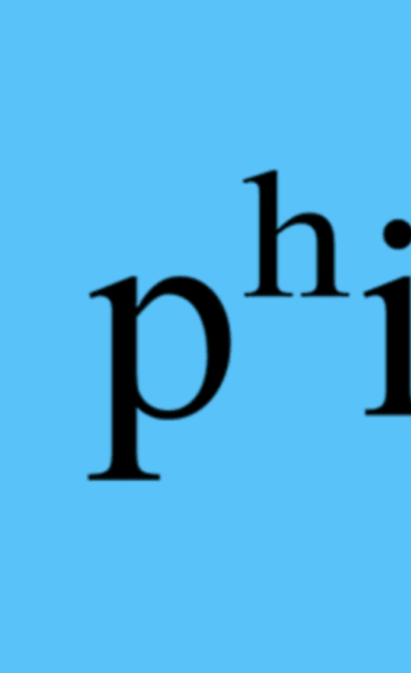
Phonetic transcription
Visual representation of speech sounds using special symbols, typically from the International Phonetic Alphabet (IPA).
IPA - Standardized system of symbols used to represent the precise pronunciation of speech sounds in any language.
Example: "think" is transcribed as /θɪŋk/, where /θ/ represents the "th" sound.

Slide 10
Difference Between Phonemic and Phonetic Transcription
Phonemic Transcription (/…/) → Broad transcription | Phonetic Transcription ([…]) → Narrow transcription
Represents only the distinctive sounds (phonemes) of a language. | Captures precise sound details like aspiration, stress, and intonation.
Does not show fine details of pronunciation. | More accurate for speech analysis.
Denoted by slashes /.../ | Denoted by square brackets […]
Example: Cat → /kæt/ Better → /ˈbɛtər/ (ignores accent variations) | Example: Cat → [kʰæt] (indicates aspirated /k/) Better → [ˈbɛɾɚ] (marks the flap sound in American English)

Slide 11
Purpose of Phonetic Transcription in the Data Science Domain:
Clarity: Ensures accurate mapping of speech sounds to text, improving the performance of speech-to-text (STT) models.
Precision: Helps capture dialectal variations and accents, making STT systems more adaptable and accurate.

Slide 12
Applications of phonetic transcription
Speech Recognition Models: Enhances phoneme-level accuracy in ASR (Automatic Speech Recognition) systems.
Text-to-Speech (TTS) Synthesis: Improves the naturalness of synthesized speech by using precise phonetic transcriptions.
Voice Assistants: Boosts language model efficiency by accurately representing pronunciation variations.
Sentiment and Emotion Analysis: Helps models detect tone and intonation differences through detailed phonetic transcriptions.

Slide 13
The International Phonetic Alphabet (IPA)
History and Significance:
Founded in 1888 by the International Phonetic Association to standardize phonetic transcription.
Significance:
Used in linguistics to document and analyze speech patterns.
Applied in speech therapy, language learning, and speech-to-text models.
Ensures clarity in pronunciation across languages, benefiting non-native speakers and linguists.

Slide 14
Major Symbols
Consonants:
Classified by place (eg. lips, tongue) and manner (stops, fricatives, etc.) of articulation.
IPA Symbol | Sound | Example Word
/p/ | Voiceless bilabial stop | pat
/b/ | Voiced bilabial stop | bat
/t/ | Voiceless alveolar stop | tap
/d/ | Voiced alveolar stop | dog
/k/ | Voiceless velar stop | cat
/g/ | Voiced velar stop | goat
/ʃ/ | Voiceless postalveolar fricative | she
/θ/ | Voiceless dental fricative | think

Slide 15
Major Symbols
Vowels:
Classified by:
Height: How high the tongue is (high, mid, low)
Backness: Position of the tongue (front, central, back)
Roundness: Shape of the lips (rounded or unrounded)
IPA Symbol | Vowel Sound | Example Word
/i:/ | Long front high vowel | see
/ɪ/ | Short front high vowel | bit
/æ/ | Low front vowel | cat
/ʌ/ | Mid-central vowel | cup
/u:/ | Long back high vowel | food
/ɔ:/ | Mid-back rounded vowel | law

Slide 16
Phonetic Transcription Rules

Slide 17
Rules for Transcribing Speech Sounds
Voicing:
Voiced sounds: Vocal cords vibrate.
Example: /b/, /d/, /g/
bat → /bæt/
Voiceless sounds: No vocal cord vibration.
Example: /p/, /t/, /k/
pat → /pæt/
Aspiration:
A small burst of air released after certain consonants.
Marked with: [ʰ] in narrow transcription.
Example:
Broad: /tʌk/ → tuck
Narrow: [tʰʌk] → aspirated /t/
Stress Marking:
Indicates emphasis on certain syllables.
Primary stress: ˈ (before the stressed syllable)
Secondary stress: ˌ (less prominent stress)
Example:
Broad: /ɪnˈtaɪɚ/ → entire
Narrow: [ɪnˈtaɪ.ɚ]

Slide 18
Lengthening and Intonation Patterns
Intonation Patterns:
Rising intonation: ↗ (for questions or uncertainty)
Falling intonation: ↘ (for statements or commands)
Example:
Broad: /ˈhaɪ, ˈhaʊ/ → rising intonation in “Hi, how are you?”
Narrow: [ˈhaɪ↗, ˈhaʊ↘]
Lengthening:
Vowel length is marked with a colon (:).
Example:
Broad: /si:/ → see (long vowel)
Broad: /sɪt/ → sit (short vowel)

Slide 19
Examples of Phonetic Transcription

Slide 20
English Examples
Word | Phonemic Transcription (/.../) | Narrow Transcription ([...])
Cat | /kæt/ | [kʰæt] (aspirated /k/)
Phone | /foʊn/ | [foʊ̃n] (nasalized vowel)
Better | /ˈbɛtər/ | [ˈbɛɾɚ] (flap /t/)
Think | /θɪŋk/ | [θɪ̃ŋk] (nasalized vowel)

Slide 21
Transcriptions in Other Languages
Language | Word | IPA Transcription
German | Buch (book) | /buːx/
French | Bonjour (hello) | /bɔ̃.ʒuʁ/
Spanish | Gracias (thank you) | /ˈɡɾa.sjas/
Japanese | こんにちは (konnichiwa - hello) | /koɴ.ni.tɕi.wa/

Slide 22
Audio examples & exercises
Website - https://linguistics.osu.edu/research/pubs/lang-files/sounds/Ch2

Slide 23
Phonetic Transcription in Data Science Applications

Slide 24
Speech-to-Text (STT) Models
Phonetic transcription helps STT systems map spoken sounds to accurate text.
Enhances recognition of accents and dialects, improving transcription accuracy.
Example:
Recognizing subtle variations like “bat” → /bæt/ vs. “pat” → /pæt/.

Slide 25
Text-to-Speech (TTS) Synthesis
Improves pronunciation accuracy by using IPA symbols for precise sound reproduction.
Enhances naturalness and fluency in synthetic speech.
Example:
TTS systems use IPA to properly pronounce homographs like:
read (present) → /riːd/
read (past) → /rɛd/

Slide 26
Sentiment and Emotion Analysis
Phonetic transcription captures intonation and stress patterns.
Helps identify tone variations, aiding in emotion detection.
Example:
Rising intonation → uncertainty or question.
Falling intonation → statement or certainty.

Slide 27
Challenges in Phonetic Transcription
3. Dialectal Variations:
English: Tomato → /təˈmɑː.təʊ/ (UK) vs. /təˈmeɪ.toʊ/ (US)
Spanish: Zapato → /θaˈpato/ (Spain) vs. /saˈpato/ (Latin America)
1. Accents and Dialects:
Same word, different pronunciation across regions.
Example:
Dance → British: /dɑːns/ → American: /dæns/
2. Suprasegmental Features:
Hard to capture intonation, stress, and rhythm.
Example:
"You're coming?" →
Falling tone → statement ↘
Rising tone → question ↗

Slide 28
Applications of Phonetic Transcription
Linguistics and Language Teaching – AI tutors
Speech Therapy and Pathology – detect and treat Speech Disorders
Forensic Phonetics – Voice Patterns
Automatic Speech Recognition (ASR) Systems – Speech To Text
Real-World Examples and Case Studies – Siri, Alexa

Slide 29
Exercise - question
Transcribe the following words into IPA:
1. Phone → /_____/
2. Ship → /_____/
3. Laugh → /_____/
4. Think → /_____/

Slide 30
Exercise - answer
Phone → /foʊn/
Ship → /ʃɪp/
Laugh → /læf/
Think → /θɪŋk/

Slide 31
Conclusion
Phonetic transcription accurately represents speech sounds, aiding in linguistics and technology.
Powers speech-to-text models and TTS systems by improving pronunciation accuracy.
Despite challenges with accents and intonation, it remains vital for speech analysis and communication tech.

Slide 32
references
IPA : https://www.internationalphoneticalphabet.org/
Phonetics : https://en.wikipedia.org/wiki/Phonetics
Book : Phonetics – Transcription, Production, Acoustics and Perception - Henning reetz and Allard Jongman.

